Slide 1
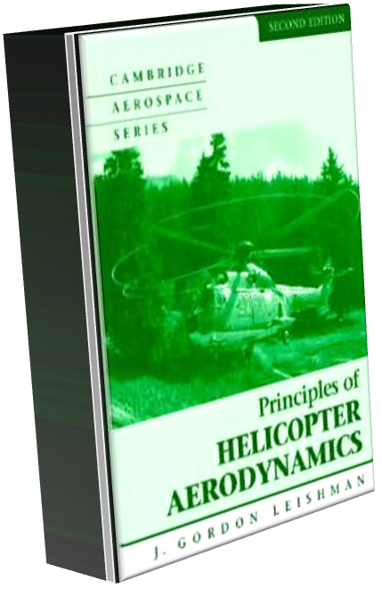
Chapter 3 Blade Element Analysis
Liang Zhe

Slide 2
Introduction
Blade Element Theory (BET)
each blade 2-D → integration for forces/moments
blade characteristics (twist, planform, airfoil shape) influence
design
induced velocities (e.g., wake) can be included
link BET and momentum theory
still used today for performance analysis

Slide 3
Outline
BET in Hovering and Axial Flight
BET in Forward Flight
Blade Element Momentum Theory

Slide 4
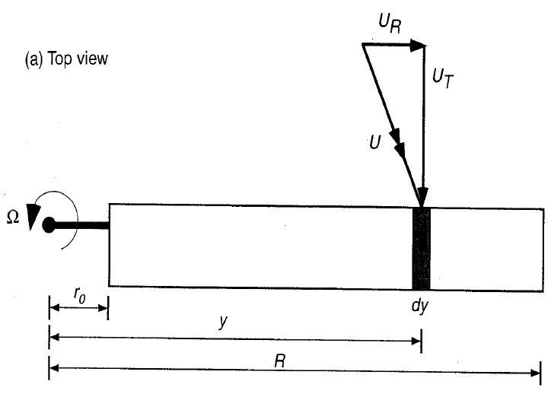


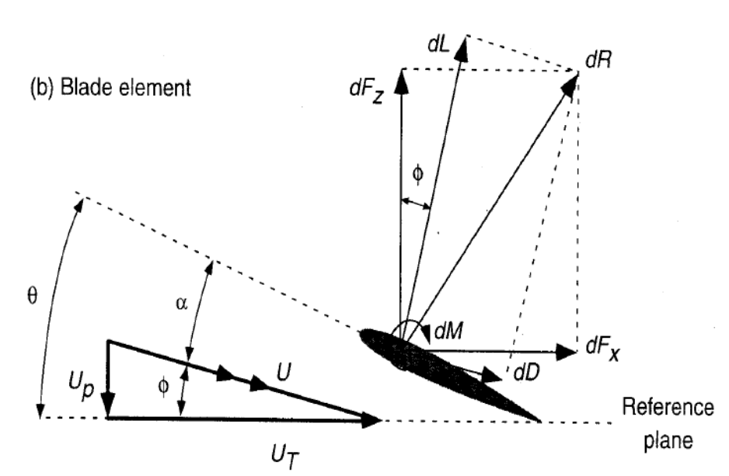
Sketch of Blade

Slide 5





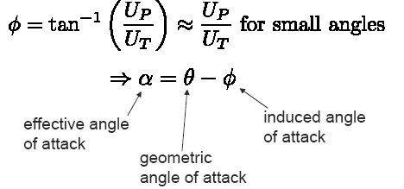
BET in Hovering and Axial Flight

Slide 6
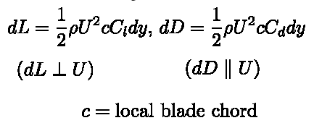

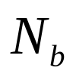
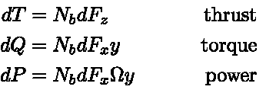



BET in Hovering and Axial Flight
is the number of blades comprising the rotor
for hover & axial flight independent of ψ

Slide 7










Simple assumptions

Slide 8

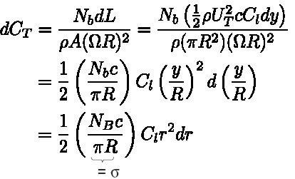




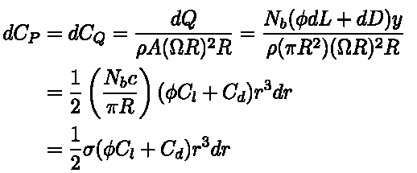


Simple assumptions

Slide 9


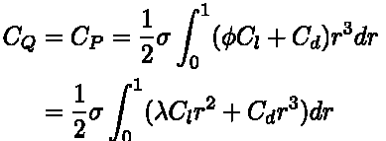
Integrated Rotor Thrust and Power

Slide 10






Thrust & Torque/Power Approximations

Slide 11




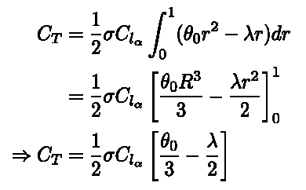
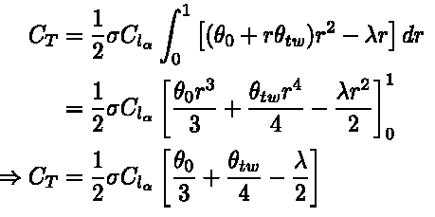


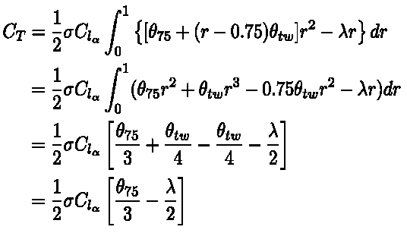

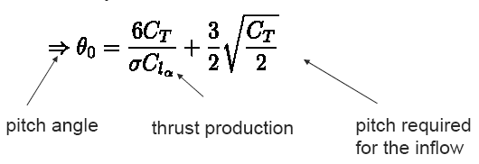

Slide 12
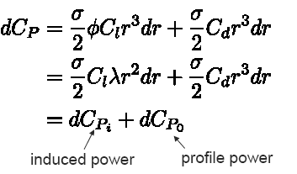







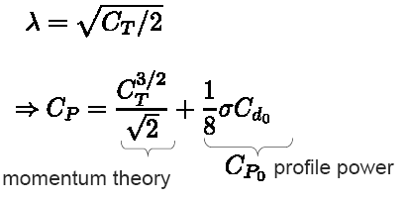
Thrust & Torque/Power Approximations

Slide 13










Tip-Loss Factor

Slide 14
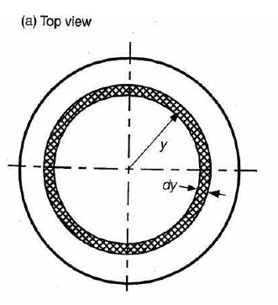




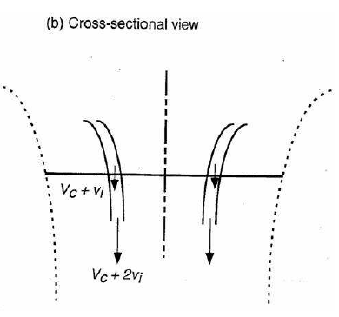

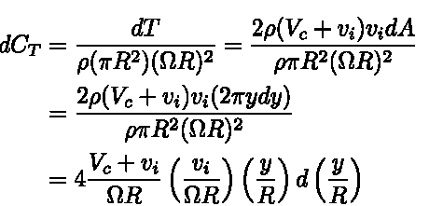


Blade Element Momentum Theory

Slide 15

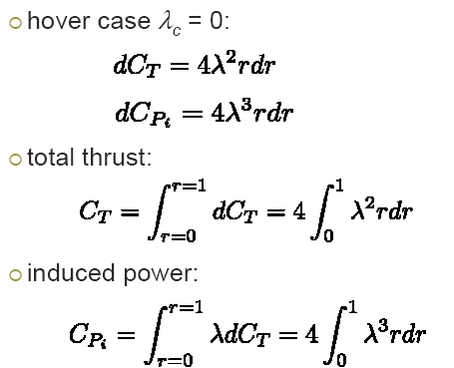



Blade Element Momentum Theory

Slide 16

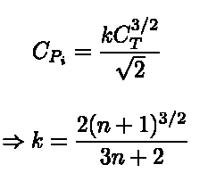




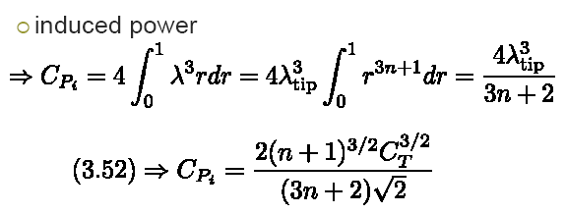
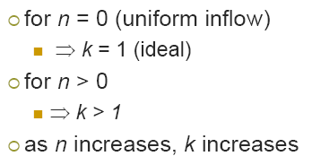
Assumed Radial Distribution of Inflow

Slide 17
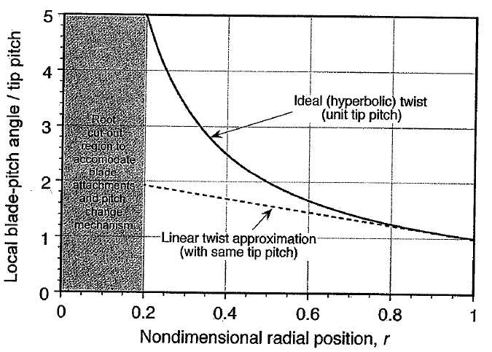
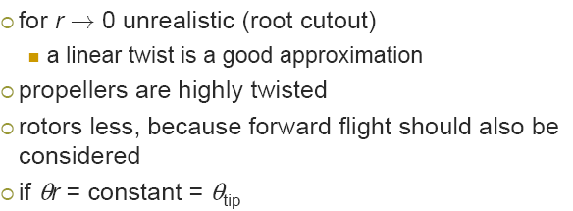
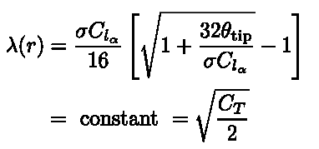







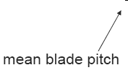

Ideal Twist

Slide 18
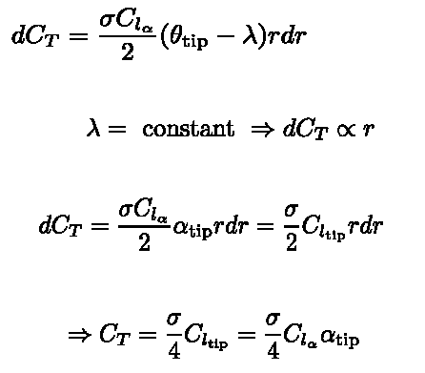
Ideal Twist

Slide 19






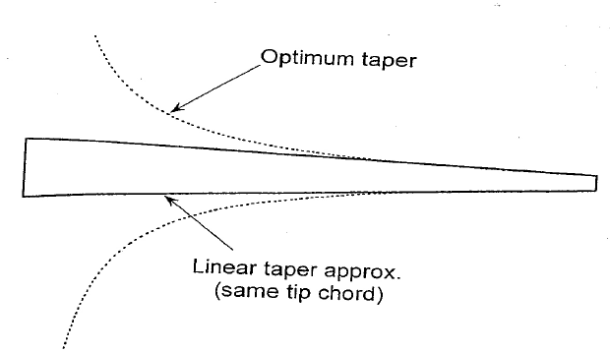



Optimum Hovering Rotor

Slide 20

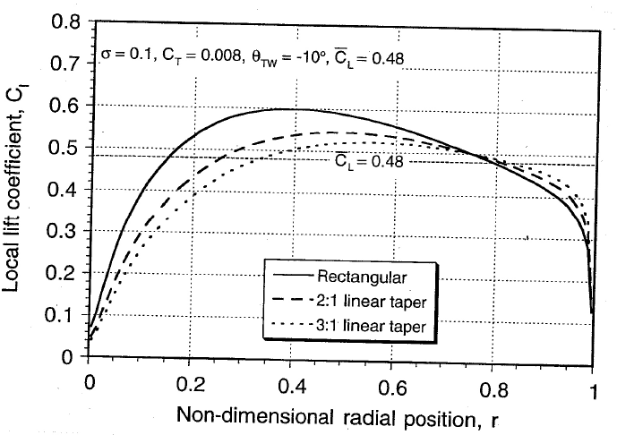








Optimum Hovering Rotor

Slide 21
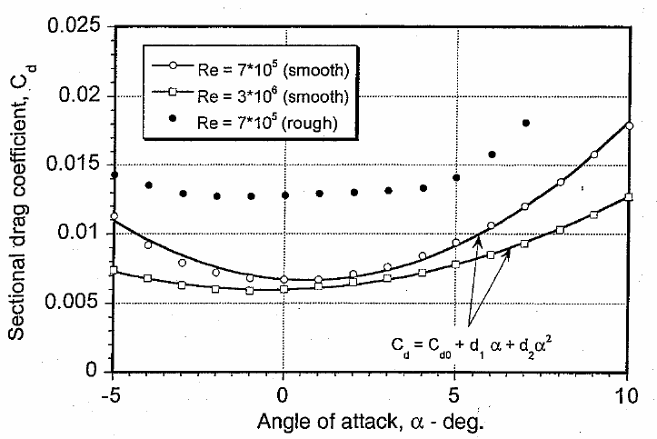









Power estimates

Slide 22

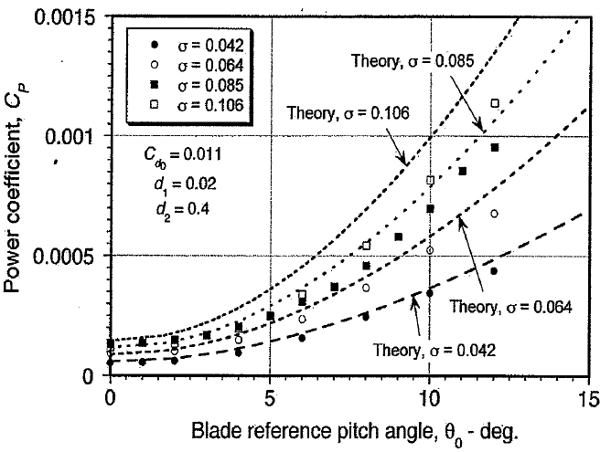




Power estimates
Solved on P17

Slide 23







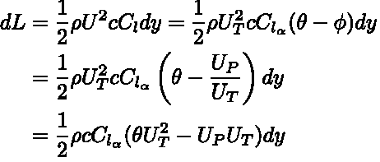

Blade Element Analysis in Forward Flight

Slide 24

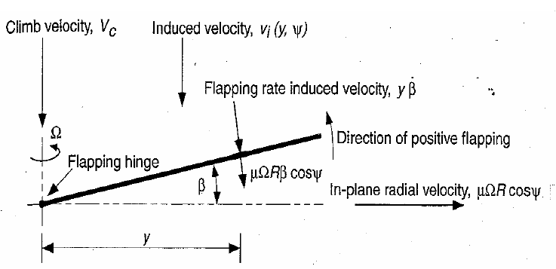
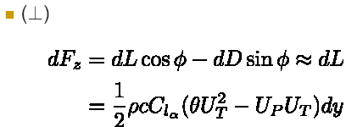
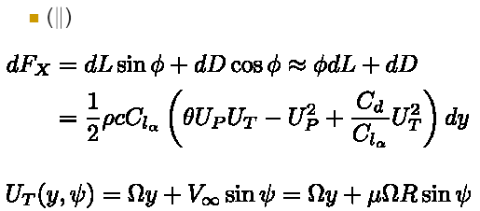



Blade Element Analysis in Forward Flight

Slide 25

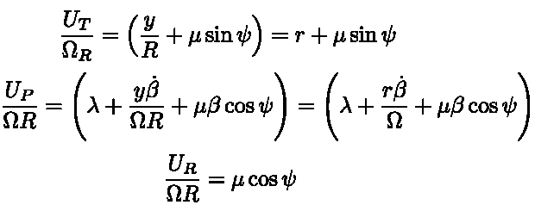
Blade Element Analysis in Forward Flight

Slide 26

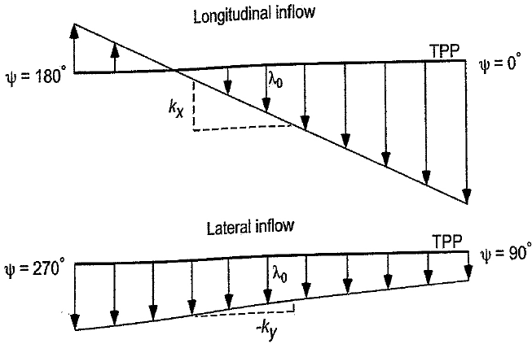





Induced Velocity Field
Chapter 2

Slide 27
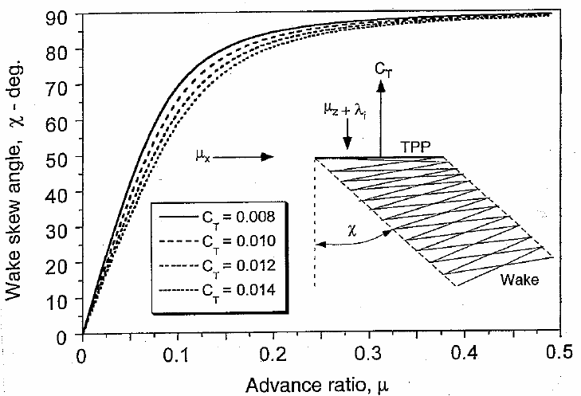








Induced Velocity Field
Coleman
Drees’ model

Slide 28
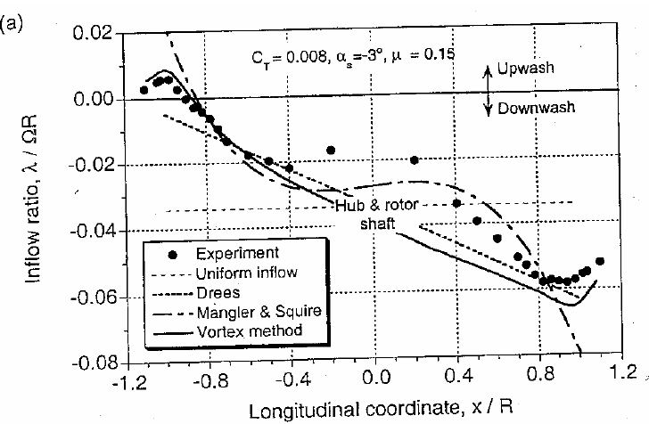

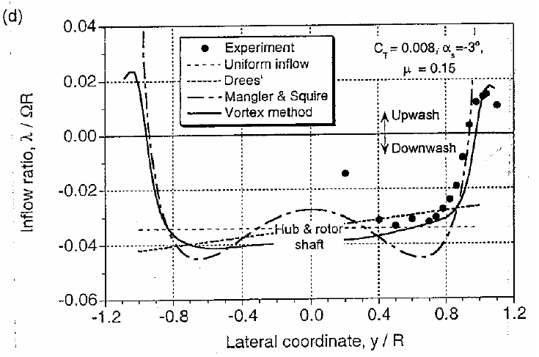

Other models
Mangler & Squire
Free-vortex wake

Slide 29
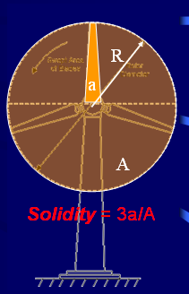






Equivalent Chords and Weighted Solidity

Slide 30



